Slide 1
Plots speak louder than data
Nishant Rathore

Slide 2
First checkpoint: Data
User data is massive and pervasive
Data is not enough to tell a story
It usually exists in a raw form with a lot of impurities
Humans are visual learners
One way to do that is visualizing with plots/graphs

Slide 3
Popular tools
Tons of libraries available to draw plots and analyze data
Javascript D3.js makes beautiful plots
We will be using Python’s Pandas libraries to analyze and manipulate
And Jupyter notebooks to document the result and story

Slide 4
Jupyter notebooks
Jupyer notebook is a web application that creates files of type .ipynb
It is available freely on the internet
In existence for roughly seven years
They are widely used for data science
Document your executable code, narrative text, and visualizations in one file
Python is the most convenient choice
Support languages such as Java, R, etc.

Slide 5
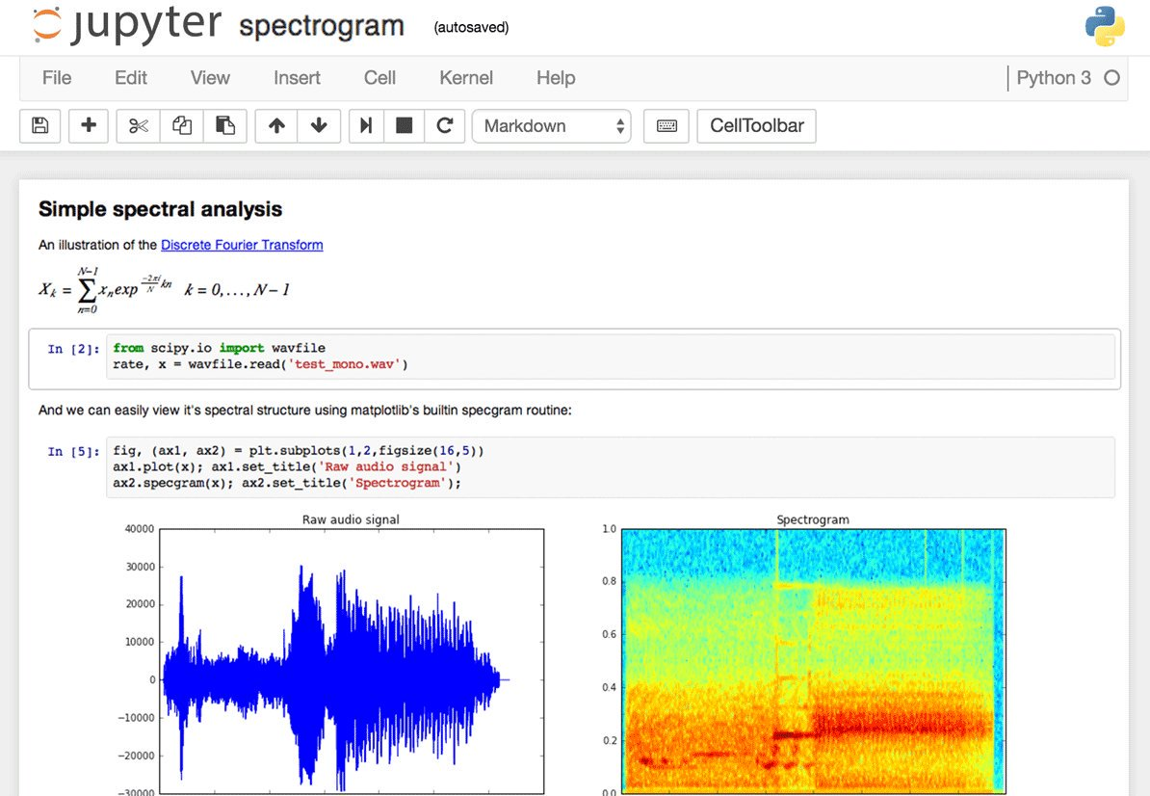
https://forums.fast.ai/uploads/default/original/2X/0/08353ad91477d4a233f7f577d88b6ef26edf16cb.jpg
Content

Slide 6
Installation
https://jupyter.org/install
Run using pip or conda command
VS Code plugin
Client server architecture
Run locally or access via a remote server
https://colab.research.google.com/
Anaconda is recommended

Slide 7
Jupyter demo

Slide 8
Pandas
Pandas is a powerful Python library for handling data
Serves many benefits such as:
Loading and manipulating data sets available in different file formats (csv, excel, etc.)
Extremely intuitive to use and fast
Common operations such as data slicing/filtering
Grouping and separation of data elements
Support converting to other data structures such as numpy, python arrays, lists

Slide 9
Pandas contd.
https://pandas.pydata.org/
Fastest way to hold your data (in python) compared to other known structures

Slide 10
Pandas demo

Slide 11
Visualization options
Data visualization is like telling a story
Python supports several visualization libraries or modules
Matplotlib, Seaborn, Plotly etc.
Matplotlib and Seaborn let you customize your plot
Seaborn plots are easier to make than those of matplotlib

Slide 12
Visualization demo

Slide 13
References:
The inspiration for this presentation came from watching lectures offered by Dr. Terrence Tricco
They are available on YouTube
https://pandas.pydata.org/
Anaconda | The World's Most Popular Data Science Platform
nishant7rathore/CommunityMeeting-PandasMatplotlib: Community Meeting - Pandas Matplotlib (github.com)

Slide 14
QA
Source code: https://github.com/nishant7rathore

